Slide 1
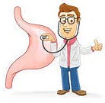
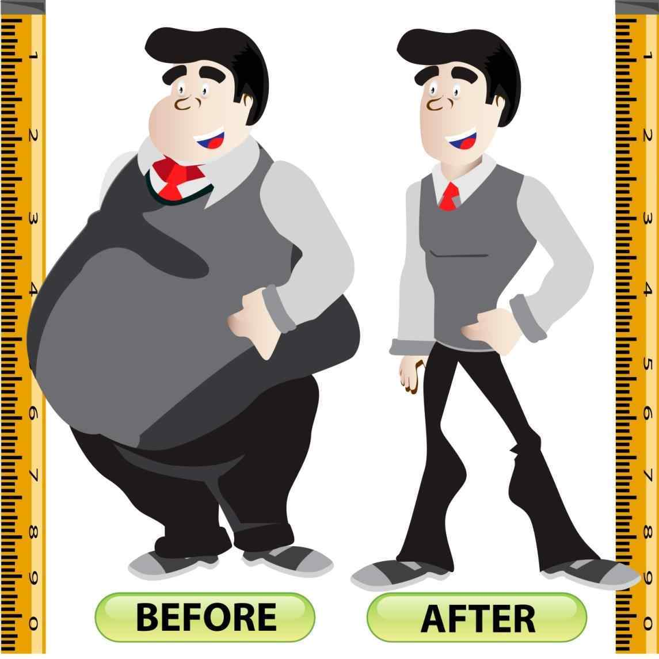
Pre-Operative Bariatric Surgery Education

Slide 2
PowerPoint Videos
I have included several videos through this presentation to make it a little less boring
In order to keep the document size small enough to share with you, I had to upload the videos to YouTube
Please click on all of the links throughout the presentation
I apologize for the lack of professionalism in the quality
Please give me a little grace, as this is my first time to make selfie videos & I did not do great. Sorry ☺
VIDEO: https://youtu.be/GPBqFE0aqkk
VIDEO: https://youtu.be/VHN09fP8_lc

Slide 3
Kenneth Bruce Jones, MD, FACS, FASMBS
Specialty: General Surgery & Bariatric Surgery

Slide 4
NEA Baptist - Jonesboro is proud to be one of six centers in Arkansas to be accredited for Bariatric Surgery
We are also a Blue
Distinction Center
with BCBS, a Center of
Excellence with UHC,
and an Institute of
Quality with Aetna.

Slide 5
MBSAQIP BSTOP (Bariatric Surgery Targeting Opioid Prescriptions)
Please read the pamphlet in your packet that says Guide to Pain Management after your bariatric or metabolic procedure
NEA Bariatric Surgery is participating in a national quality project
Your pain will be treated
The pamphlet provides you with education about pain management and opioids
You will be asked some questions at your first follow up appointment about your pain medication prescription you are given at discharge
VIDEO: https://youtu.be/302J5aelNfE

Slide 6
Bariatric Surgery Folder Contents (PLEASE READ ALL HANDOUTS)
Contact info for Gayla Smith, Bariatric Coordinator and Tina Harris, Dietician
*Not in Folder* Dr. Jones’ office phone number: 870-936-8000
Agenda
Bariatric Surgery Pre-op Notes
Bariatric Surgery Diet
Bariatric Surgery Complications
Bariatric Surgery “Rules”
Counseling Contacts
BSTOP Pamphlet
Incentive Spirometry
Drink, Drink, and Drink Some More
All About Hair Loss
Vitamin & Mineral Supplements
Supplements after Surgery
Crave This, Eat That
Healthy Substitutions
Visual Cheat Sheet for Protein
Food Journal

Slide 7
Research has proven those people who get support are much more successful at weight loss and maintenance. Come to support group.
See bottom of flyer for name of Facebook support group - we will accept you to that group after you’ve had surgery.
Additional support resources: https://neabaptistclinic.com/weight-loss/resources/
VIDEO: https://youtu.be/QTB-iBWMQ3I

Slide 8
Respiratory Health
PLEASE read incentive spirometry handout & click the link below to watch instructions
Dr. Jones expects for you to practice this at home to prepare for your hospital stay.
Your lungs will be a little lazy after having anesthesia and you will be sore in your abdomen which will decrease your drive to take deep breaths.
This devise encourages you to take deep breaths and cough to help prevent pneumonia or atelectasis.
The handout gives instruction on how to preform the exercise. Make sure to set your goal (tab on side) about 500 to 1,000 above your best effort to continue to improve.
Do NOT use this and then stand up quickly because it could make you light headed and potentially cause a fall.
Step 3 in the instructions says to hold breath as prescribed – you can hold for 1-2 seconds and then exhale.
Dr. Jones expects for you to use this device 10 times per hour while you are awake in the hospital.
VIDEO: https://youtu.be/VHN5zPaw96w

Slide 9
General Information for Laparoscopic Surgery
Hospital Stay – 1 night (typically discharged in the afternoon not morning)
Surgery Length – 1.5 to 2 hours of OR time (away from family approx. 4 hours)
Additional Surgery – If you have scar tissue or hiatal hernia that can increase OR time by approx. 30 minutes to 1.5 hours
Open Surgery – If you have to have one incision instead of a laparoscopic surgery; you will spend at least one extra night in the hospital and OR time will vary.

Slide 10
Digestive Tract Before & After Bariatric Surgery
The next three slides show normal digestive anatomy and then the four approved weight loss surgery options.
Note the size of the stomach in the first picture compared to the gastric sleeve and gastric bypass surgeries.
The stomach is very small after surgery and you will have swelling inside your stomach after surgery for a little while.
The swelling will limit what can be swallowed into the stomach for a period of time.
VIDEO: https://youtu.be/hS9EDfqDZiM
Nothing larger than a baby aspirin until Dr. Jones
or his staff release you to do so

Slide 11
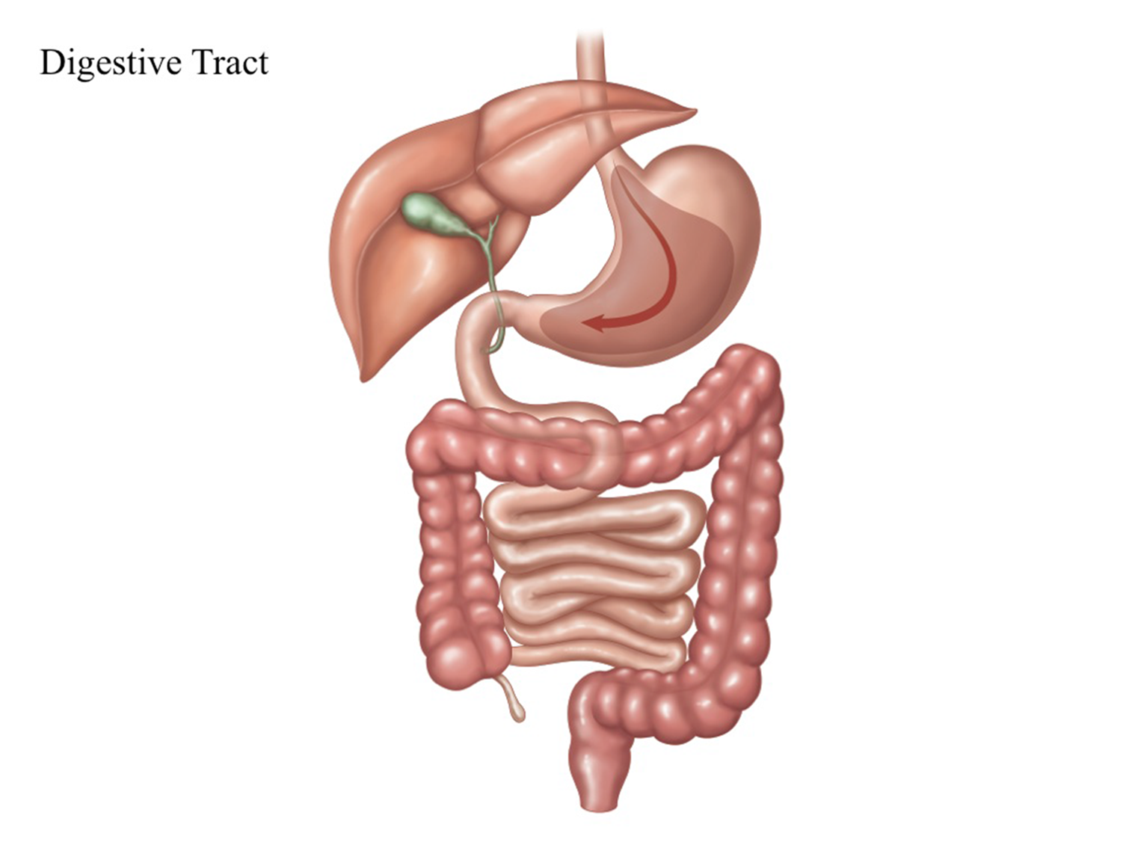

Slide 12
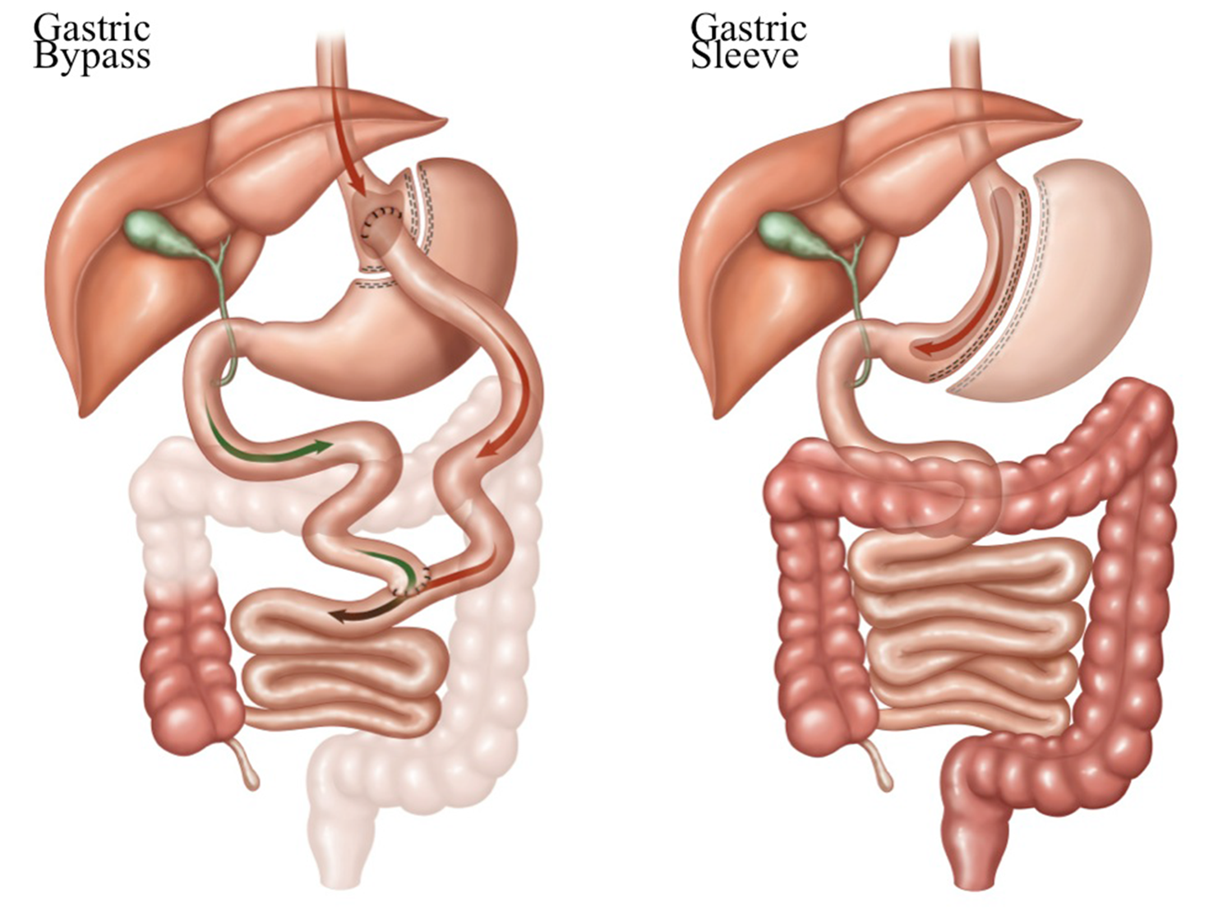

Slide 13
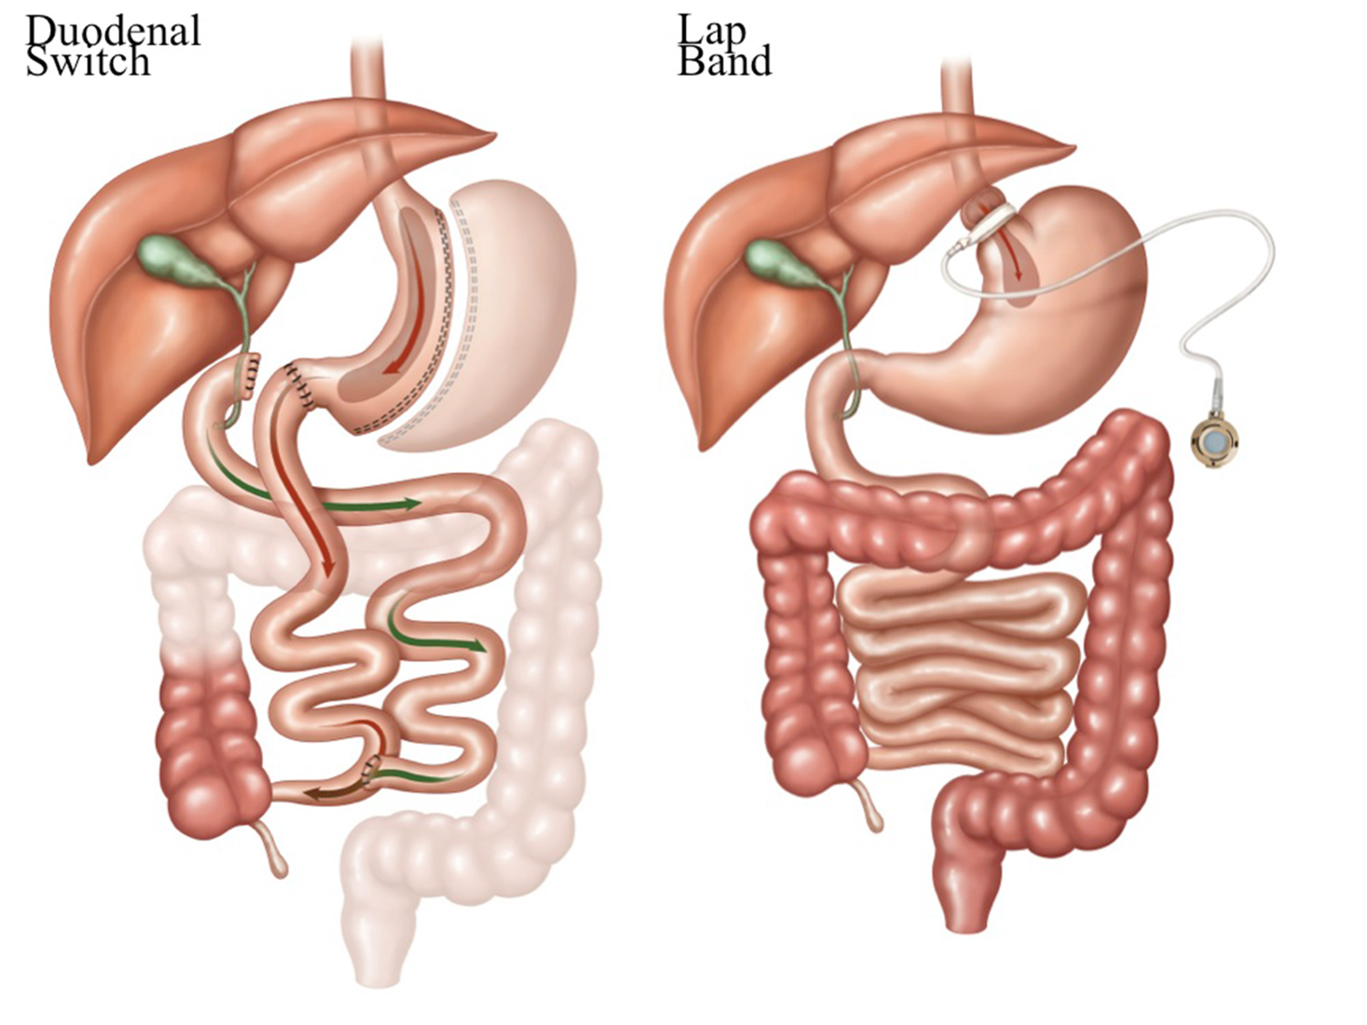

Slide 14
How Does Weight Loss Surgery Work
Magic? – NOPE
Restriction: Small amount of food = small amount of calories. Does that many eat anything? - NO. Food choices matter & will affect hunger level.
Malabsorption: Not everything is absorbed that is put in so make every bite count. ☺ (Sleeve gastrectomy patients only have slight malabsorption)
Decreased hunger: Hunger hormones likely originate from area of stomach removed or bypassed. Smaller space helps the use of the nerves at the top of the stomach.

Slide 15
Your Biggest Priority Immediately Following Surgery
HYDRATION
Learn to sip slowly. It will not be as easy to drink in the beginning.
Pay attention to temperature and swallowing of a air if you are having discomfort.
Measure the amount you are able to consume.
VIDEO: https://youtu.be/PBr3X_mCb1w
You can count it toward your water consumption if it
meets these criteria:
- Sugar / Fat Free (may use artificial sweetener)
- Caffeine Free
- Carbonation Free

Slide 16
NO’s for Liquid Consumption
No fat – GI distress & not part of long term eating plan.
No sugar – GI distress & not part of long term eating plan.
No caffeine – Acts as a diuretic and can increase your risk of dehydration. You may reintroduce once you are able to consume the recommended daily amount (8 – 8oz. servings {48-64ozs.} per day - I was able to do this around 4 months post-op)
No carbonation – Can cause gas pain & chronic dilation of sleeve or pouch.
No straw – Can swallow air and cause gas pain.

Slide 17
Long Term Diet
PLEASE read Bariatric Surgery “Rules” handout
It is YOUR responsibility to learn how to use your new tool
We do and will provide you with many resources to help you
We are committed to your success so please utilize what we offer
Support Group and Nutrition Class are GREAT resources for you

Slide 18
Major Keys To Success From Dr. Jones
Food Choices
Exercise
Timing of Liquids
Avoid liquid calories
Avoid snacking when not hungry
Avoid carbonation - I added this one ☺

Slide 19
Hierarchy of Needs Post Bariatric Surgery
Fluid: 48-64 oz. / day of non-caloric clear liquid
Protein: 60g for women & 80g for men – incorporate protein in each 4 oz. meal 3-4 times daily
Veggies: Make one meal daily a salad (can increase volume to 8oz)
Starch (AKA: Carbohydrates): Does not provide nutrition unless it’s a vegetable, like: corn, beans, potatoes. You get to decide what is most important each time you eat. Nutrition Vs ________ – Health or making eating entertainment / pleasure.
****TAKE YOUR DAILY VITAMINS AS INSTRUCTED****

Slide 20
Vitamins are a Must for Life
VIDEO: https://youtu.be/IkF328_F6hQ
Lap Gastric Sleeve
Multivitamin with Iron
B12
Calcium with Vitamin D
Iron: 45-65 mg
B12: 500 mcg
Calcium: 500-1000 mg
Vitamin D3: 200-400 IU
Take Iron & Calcium 2 hours apart
Gastric Bypass
Multivitamin
Iron - Integra or Tandem
B12
Calcium with Vitamin D
Protein – rarely
****NO GUMMIES****USE CHEWABLE until Dr. Jones allows you to swallow pills****

Slide 21
Post Bariatric Surgery Diet
PLEASE read Post Bariatric Surgery Diet Handout thoroughly
Put handout near refrigerator & leave on page of your current stage
DO NOT progress your diet without Dr. Jones’ or his staff’s instruction
The handout volumes are SUGGESTIONS & limits – Do NOT overeat
When measuring food – Look at Volume not Weight (use measuring cup/spoon)
Think of texture when advancing – as you would introduce foods to a baby…..Thin liquid/food initially & increasing thickness with each advancing stage
Slow Down – This is one of the hardest things to do (baby spoon/fork may help)
Make good food choices – avoid fried, high fat, & high sugar foods
VIDEO: https://youtu.be/EV-Sc6yHQSM

Slide 22
Post Bariatric Surgery Diet Continued
Make sure that protein is the star in each meal & eat it first
The handout explains the stages used when advancing your diet after surgery, typically tolerated volumes and limits, estimated time frames, and sample food options for each stage that are typically comfortable/tolerated & uncomfortable/not tolerated
Everyone is different on how fast they progress through the diet and advance to regular food again - If you do not tolerate a certain food/stage, go back to the previous stage for a day or two and then try to advance to the next stage again
Meals should take at least 20 minutes & no longer than 30 minutes
For all diet stages: you may drink clear liquids up to meal time, stop drinking during your meal, and resume drinking 30 minutes after your meal

Slide 23
Stage 1: Clear Liquids
Liquids that you can see a utensil through
If it would be liquid at body temperature (meaning frozen & gelled foods included)
Goal: 48-64 oz./day (It will take some time to reach- It most likely will NOT happen for a couple weeks)
Limit: 2oz./hour the day after surgery (the next day start to increase if tolerated well)
Make sure to measure liquids (to insure that you know how much is being consumed)
Sip instead of gulp (you will cause discomfort by swallowing more air if you drink too fast)
Pay attention to temperature (room temperature is often most comfortable)
Avoid sugar & fat (you may use artificial sweetener of choice - avoid high carbohydrate options)
See Slide #15 - NO’s for Liquid Consumption

Slide 24
Stage 2: Full Liquids
Thicker than clear liquid but still smooth texture with no bits or chunks of food
Can have a milky consistency
You can strain things like cream soup if there are bits of food present
Even though it is liquid this is considered eating
Start to gradually increase protein intake (Goal: Men – 80 grams/day & Women – 60 grams/day) – it will take time to reach this goal
You may add protein powder or dry milk to your food to increase protein consumption
****Start vitamins with this stage****

Slide 25
Stage 2: Full Liquids Continued (Week Two)
You may increase the texture to foods that are easing into the next stage except NO MEAT
Foods with texture like refined cereals or cream of wheat – you will need to make it thin with extra liquid
Soft food like cottage cheese or really soft scrambled eggs
**Make sure these are chewed to a liquid prior to swallowing**
Foods that are already pureed like apple sauce
You can try refried beans that are really thin but avoid skins and melty cheese

Slide 26
Stage 3: Pureed
Foods without skins, seeds, strings, or hulls that can be blended to a smooth (baby food) consistency
NO BABY FOOD
Even though the food has been blended still chew and make sure to swallow only when food is smooth and thin
Foods like soft baked fish or bananas could be masked with fork and chewed well instead of blending if that is more palatable
TIP: You can puree foods in advance and freeze in ice cube trays to equal 2oz. servings. Use broth or marinade as your blending liquid instead of water to make food taste good.

Slide 27
Stage 4: Soft
Eat soft foods & continue to chew to a smooth mush, almost liquid, before swallowing – no bits or chunks
Now you may add lean ground meats and creamy or whipped peanut butter to your diet
Continue to avoid skins, seeds, strings, & hulls
Soft breads will most likely NOT be tolerated – gums up and does not pass well through your sleeve or pouch
REMEMBER: We do not push for low/no carb dieting BUT be picky about your carbohydrate choices. Many (bread, pasta, rice, crackers, cookies, candy) do not offer any nutrition and can be eliminated in your new, healthy lifestyle. If you choose to eat carbohydrates make them nutritious and beneficial to your health (fruits/veggies/legumes/nuts/seeds). Also, carbohydrates will increase hunger and cravings.

Slide 28
Stage 5: Regular
Introduce new foods/textures slowly & if you do not tolerate something try again later
Cut whole pieces of meat into small ¼ inch pieces so if accidently swallowed it will still pass through sleeve or pouch
Tough or dry meats & raw vegetables may take some time to tolerate so advance slowly
Always measure portions – goal: at or under 4oz. servings per meal
Continue to make healthy food choices by avoiding fried, cakey, bready, fatty, or sugary foods

Slide 29
Medications
Make sure to take all your medications with you to your PAT (Pre-Admitting Testing) appointment
You will not swallow anything larger than a baby aspirin for approximately 4 weeks after surgery
You will be given instruction on how to take your home medication prior to discharging from the hospital
VIDEO: https://youtu.be/wASEteqSRyY

Slide 30
Medications Continued
Use a back up birth control method for thirty days after surgery if you use any type of hormone contraceptive – this includes implants and IUDs – you will be given a medication in the hospital that impairs the effectiveness of birth control
***NO PREGNANCIES FOR 2 YEARS AFTER SURGERY***
If you have ovaries & uterus without tubal ligation – You MUST use some type of contraceptive for 2 years even if you have not had a period in a very long time
It is VERY likely that with a some weight loss you will start making eggs again & be able to get pregnant!!!!

Slide 31
Medications Continued
Diuretic, Antihypertensive, & Antidiabetic Medications: Make sure you assess the diseases that you take these medications for even if you are taken off the medication at hospital discharge & notify us if you have abnormal results
Aspirin: You may only take this if your doctor prescribed and you use enteric coated
NSAIDs: May NOT take chronically by mouth anymore - May cause ulceration or bleeding in the stomach (examples: Ibuprofen, Aleve, Meloxicam, Toradol) Non-oral routes are acceptable (topical/injection)

Slide 32
What to Expect in the Hospital
IV: You will get medications & fluids through a tube in your vein
PCA (Patient Controlled Anesthesia): You will have a button to push when you need pain medication – This is NOT for family to push
Nausea Medication: You will receive through your IV on schedule for 24 hours after surgery – you will need to request it if past 24 hours
Blood Thinner: Will be a small dose shot in belly to prevent blood clot
SCDs (Sequential Compression Devices): Squeeze calves to prevent blood clot – MUST be in use unless you are walking
Drain: Bulb on the end of a small tube that enters your abdomen – the tube sits near your stomach staple line (This is typically removed prior to discharge from the hospital)

Slide 33
Suggested Items to Bring to The Hospital
Chewable Gas Reducer such as GasX – any brand with GasX active ingredient that is chewable will work
Mouth Lubricant – See products by mouth wash – my favorite is Biotene
Comfortable Shoes – slip on is fine but stable that you can walk in
Personal Care Items
ChapStick
Approved Clear Liquids – Protein water, Powerade Zero, Propel
Long Phone Charger or Extension Cord

Slide 34
Early Ambulation
This is Dr. Jones EXPECTATION
You will be up to the bathroom & around in your room the day of surgery
You will walk in the hallway the morning after surgery
You should be up in chair during waking hours as much as possible
At home: walk or flex calves hourly while awake to prevent blood clot
VIDEO: https://youtu.be/_acN0RKJU_M
****If your activity is decreased due to illness or injury within a
year after surgery PLEASE notify us****
VIDEO CORRECTION: Incentive Spirometer is to be done 10 x per hour while awake – not just 10 x per day ☺

Slide 35
COMPLICATIONS Report to Dr. Jones’ Office – 870-936-8000
Elevated heart rate
Fever greater than 100.5 degrees Fahrenheit
Excessive, severe, or increased abdominal pain
Colored or foul smelling drainage from any surgical site
Shortness of breath
Leg pain
Continuous or frequent vomiting
Continuous or frequent diarrhea
Inability to take in fluids
Dehydration – Dry skin/mouth, extreme weakness, decreased urine output
VIDEO: https://youtu.be/Y1wMXCbx2gg

Slide 36
Hospital Discharge
Your nurse will go over your discharge instructions before you leave the hospital
Please ask questions if you do not understand something
Your instructions will include how you are to take home medications
Your instructions will include how to care for your incisions – PLEASE call if you have questions when you get home – do not disturb steri-strips but do not leave on other dressings on, unless instructed to do so, when you shower
Wash with soap and water – no lotions, creams, or powders near incisions
No submersion in water (tub bath or swimming) until Dr. Jones’ office releases you

Slide 37
Medical Follow Up
When you signed your surgery consent, you also signed a follow up agreement
The agreement is to keep scheduled appointments with the surgical office at one week, three weeks, two months, six months, one year, eighteen months, & then yearly for life
The bariatric surgery office will insure that you are not having any vitamin/mineral deficiencies and you are getting the best possible benefit from your new tool

Slide 38
Emotional / Mental Effects From Surgery
Greif and/or depression can present after surgery due to the inability to use food as your coping mechanism
Be kind to yourself and allow yourself room to have feelings even if they’re not positive
Do NOT feel like you’re alone & know these feelings are not because there is something wrong with you
Reach out to our support group
Set up counseling – you may contact us & we will make a referral for you or see counseling contacts in your folder
Remember: These feelings are usually temporary & you will most likely be extremely grateful for your new tool sooner than later
VIDEO: https://youtu.be/69URDgNa43E

Slide 39
Surgical Expectations
Weight loss surgery is not magic - even though it feels like it the first year
Use the year to eighteen months after surgery to start developing good habits while it’s easy because later on comes & you will get some of your cravings & appetite back - See your Bariatric Surgery “Rules” handout to help get you started on the right path
Take time to assess mental vs physical hunger & relearn your signs of each – treat each appropriately – if physically hungry then eat but don’t if not
It’s YOUR responsibility to learn how to use your new tool (Support Group & Nutrition Class is a great place to start ☺)
Everyone loses weight at a different pace – don’t compare
Weight loss stalls WILL happen throughout the process – Do NOT stress over it & get off the scale (weigh once per week unless you have heart failure)

Slide 40
PRE-OP DIET
Follow instructions given to you by Dr. Jones’ office
It can be difficult but YOU can do it
You may not see the scale move daily but you should have an average weight loss of a pound per day at the end of the diet
Dr. Jones knows you followed the diet by your weight loss
Dr. Jones would not ask you to do it if it were not important
VIDEO: https://youtu.be/by8uY14-Dyg

Slide 41
Extra Info
Exercise is a MUST: Regular exercise changes the needs of your cells. It is a big game changer for weight loss but more so for maintenance. Dr. Jones wants you to at least walk 20 minutes five days per week.
Post op swelling: You will likely weigh more when you get home after surgery than you did when you checked in due to the amount of IV fluids given during your hospitalization.
Where to get vitamins: You can order brands like Bariatric Advantage, Celebrate, & Fusion online (most have coupons) or you can purchase locally brands like Flintstone Complete (take 2) & Caltrate Chewable.

